Slide 1


Introducing IRIS
Data collection Instruments for Research Into Second language learning and teaching
http://www.iris-database.org
Emma Marsden (York)
Alison Mackey (Georgetown)

Slide 2
What is IRIS?
Instruments for Research into Second Languages
A sustainable, central digital repository
Up- and downloadable; freely accessible
Searchable across a wide range of parameters
  e.g. instrument type; research area; participant characteristics (incl. teachers, learners, trainees); L1; L2; language feature(s); proficiency
Independent: Cross-institution, -country, -journal, -publisher, -funder
Currently funded by ESRC & a long-term British Academy Research Project
Sustainable infrastructure of University of York’s Digital Library

Slide 3
Scope
The scope of IRIS is as wide as the field of L2 research, including…
L2 production
Language learning
…in diverse contexts
…with diverse types of data
… with diverse research aims
L2 perception& identity
Education & policy
Phonology
Grammar
Vocabulary
Pragmatics
Language teaching

Slide 4
Rationale behind IRIS
Currently:
Researchers create and keep own instruments
(…re-invention of wheel, systematic research???)
Maintenance and access to the instruments is ad hoc
Usually brief descriptions with occasional short samples available in published work
Contrast between:
Complete data collection instruments vs. samples in appendix

Slide 5
Submission online, or via email
http://www.iris-database.org OR
Email: iris@iris-database.org
Criteria for upload:
Instrument used to collect data published in a peer-reviewed:
  Journal article
  Book/chapter
  Conference proceedings
  Or an approved PhD thesis

Slide 6
Usage to date
August 2012: Fully live
Over 900 downloads
Over 4500 visits to site
Over 150 data collection instruments

Slide 7
Feedback features & quality assurance
Downloaders can feedback about:
    further use of an instrument, new contextual information
    problems
    updated reliability statistics (generalisability)
Uploader encouraged to allow on-line comments
  Or can request feedback to be sent personally to them
  Or refuse feedback
Uploader informed when their instrument has been downloaded (citations; impact)
Enhance transparency, evaluation and, eventually, quality

Slide 8
Ethical issues...copyright
Creative commons licensing
  Promoting: derivatives allowed; non-commercial; share-alike
Awareness that instruments are often built on previous instrument
IRIS team helps to pursue permission requests
Acknowledgements are uploaders’ ultimate responsibility

Slide 9
Support from potential users
Center for Applied Linguistics, US (Donna Christian, President)
Committee for Linguistics in Education, UK (Graeme Trousdale, Chair)
Early Language Learning in Europe (Janet Enever, Director)
Higher Education Academy’s Subject Centre for Languages, Linguistics and Area Studies, UK (Mike Kelly, Director)
International Association for Teachers of English as a Foreign Language (Herbert Puchta, President)
Language Learning Journal (Norbert Pachler, Co-Editor)
Modern Language Association’s Committee on Information Technology, US (Barbara Lafford)
Research Special Interest Group of the International Association for Teachers of English as a Foreign Language (Anthony Bruton, Co-ordinator)
UKOLN, Centre of Excellence in Digital Information Management (Michael Day, Research and Development Manager and Team Leader, UKOLN, University of Bath, UK)

Slide 10
Support from research community
Letters from journal editors
Annual Review of Applied Linguistics (Charlene Polio, Editor-in-Chief)
Bilingualism: Language and Cognition (Ping Li, Co-ordinating Editor)
International Journal of Bilingualism (Li Wei, Editor)
Journal of French Language Studies (Florence Myles, Chief Editor)
Language Learning (Robert DeKeyser, outgoing Editor, and Lourdes Ortega, incoming Editor)
Language Teaching (Graeme Porte, Editor)
Language Teaching Research (Rod Ellis, Editor)
Language Policy (Kendall King, Editor)
Second Language Research (John Archibald, Co-Editor)
Studies in Second Language Acquisition (Susan Gass, Associate Editor)
System (Norman Davies, General Editor)
Letters from presidents of professional research associations
American Association for Applied Linguistics (AAAL) (Jeff Connor-Linton, President)
British Association of Applied Linguistics (BAAL) (Susan Hunston, Acting Chair)
European Second Language Association (EUROSLA) (Jean-Marc Dewaele, President)
International Association for Applied Linguistics (AILA) (Martin Bygate, President)
Language Learning and Teaching Special Interest Group (BAAL LLT SIG) (Suzanne Graham, Convenor)
Linguistics Association of Great Britain (LAGB) (Kersti Börjars, President)

Slide 11
The IRIS Advisory Board
Michael Day (UKOLN Centre of Excellence in Digital Information Management, University of Bath, UK)
Professor Rod Ellis (University of Auckland, New Zealand, and Cheung Kong Scholar Professor, Shanghai International Studies University, China)
Professor Susan Gass (Michigan State University, US)
Professor Jan Hulstijn (University of Amsterdam, Netherlands)
Dr. Judith Klavans (University of Maryland Institute for Advanced Computer Studies, US)
Professor David Martin (ESRC National Centre for Research Methods and ReStore Sustainable Web Resources Repository project, University of Southampton, UK)
Professor Lourdes Ortega (Georgetown University, US)
Professor Leah Roberts (University of York, UK)
Professor Norman Segalowitz (Concordia University, Montréal, Canada)
Professor Peter Skehan (Emeritus, Chinese University of Hong Kong, China)

Slide 12
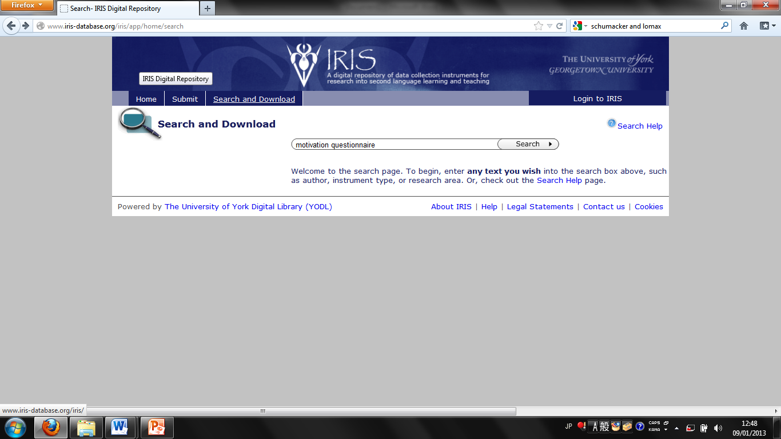
Instrument type:
Motivation Questionnaire

Slide 13
Research article
Instrument
[Excerpt; Farsi version also available]
Taguchi, T., Magid, M., & Papi, M. (2009)
The L2 motivational self system among Chinese, Japanese and Iranian learners of English: A comparative study

Slide 14
Instrument characteristics
Research area
Motivation
Research question
To test the “L2 Motivational Self System” (Dörnyei, 2005) on Japanese, Chinese and Iranian learners of English (especially with regard to the “ideal L2 self”, “integrativeness” and “instrumentality”)

Slide 15
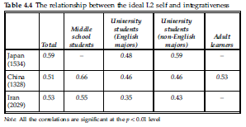
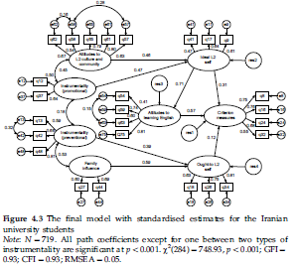
Data elicited by instrument
After a correlational analysis
After a structural equation modelling (SEM) analysis
Conclusions
The “L2 Motivational Self System” is not country specific
“Integrativeness” can be relabelled the “ideal L2 self”

Slide 16
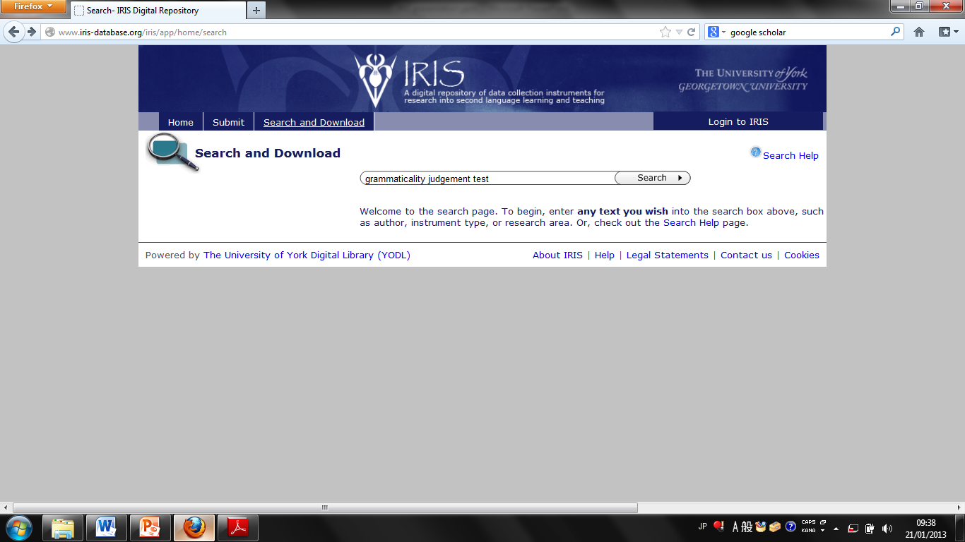
Instrument type:
Grammaticality Judgement Test

Slide 17
Research article
Instrument
Test 1
*Elle était plus courageux que son frère
*J’ai revenu des vacances et j’ai repris mon travail
Arc-en-Ciel était le plus beau poisson des océans.
*La femme n’était pas belle mais elle était très intelligent.
La fille est devenue de plus en plus belle.
Je lui demande s’il est allé à l’école hier
*Il vient de s’acheter une grand voiture.
Une femme ambitieuse n’est jamais satisfaite.
[Excerpt]
Erlam, R., & Loewen, S. (2010)
Implicit and explicit recasts in L2 oral French interaction

Slide 18
Instrument characteristics
Research areas
Morphosyntax
Teaching methods
Research question
To examine the effectiveness of implicit and explicit corrective feedback
Focus on noun–adjective agreement in American learners of French, which is difficult to acquire even after many years of exposure (Harley, 1989)

Slide 19
Data elicited by instrument
Participants had 1 hour of instruction with either explicit or implicit feedback
Participants took the grammaticality judgement test (pre-test, post-test, delayed post test)
Participants got 1 point for every sentence they (a) recognised as ungrammatical and (b) corrected (scores were reported as means)
No difference was found between explicit and implicit feedback (Perhaps the implicit feedback was too salient because of the experimental setting?)

Slide 20
References
Taguchi, T., Magid, M., & Papi, M. (2009). The L2 motivational self system among Chinese, Japanese and Iranian learners of English: A comparative study. In Z. Dornyei & E. Ushioda (Eds.), Motivation, language identity and the L2 self (pp. 66-97). Multilingual Matters.
Erlam, R., & Loewen, S. (2010). Implicit and explicit recasts in L2 oral French interaction. Canadian Modern Language Review, 66(6), 887-916.

Slide 21
Finally...
See www.iris-database.org for more information
For help and support, e-mail: iris@iris-database.org
Please help to raise awareness
Upload an instrument
  Approx. 15 minutes, to make IRIS a sustained and integral part of our community’s practice

Slide 22
Thanks too
Julie Allinson (York Digital Library Manager)
Frank Feng (IRIS systems developer)
Julia Key (IRIS project assistant)
Becky Taylor (IRIS research assistant)
All the IRIS contributors to date (over 600 authors).

Slide 23
Sample instruments (1)
(Silver, 2000)

Slide 24
Sample instruments (2)
(Taylor, 2010)

Slide 25
Sample instruments (3)
(Garcia Mayo, 2002)

